Slide 1
Web Development with Django
Shehab Sarar Ahmed
Email: shehabsararahmed03@gmail.com

Slide 2
Recap
What we have done so far?
MVT Pattern
Creating Models
Admin panel

Slide 3
This class
We haven’t worked with the template part of django
DTL -> Django Template Language

Slide 4

Template
Remember, we returned an HttpResponse from index method in views file
Just to show a text in the posts/ url
We will now render an HTML file from the index method
We are telling django to load the index.html file inside the posts folder

Slide 5
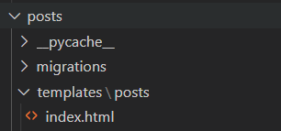
Template
We will have to create a posts folder inside templates folder
Templates folder will be inside the main app’s folder
Why?
Django wants this hierarchy

Slide 6
Template
Now, write your html code in the index.html file
You will be able to see the output in localhost:8000/posts url

Slide 7
Template
Often a case arises that you will need same design in many pages
Navigation bar
Title and design of tab etc.
It would be nice to have a single file and include them in all the pages you need

Slide 8
Layout
Create a layout.html file inside the posts folder
Write ! and then press tab
Basic skeleton of HTML code is written for you
Change the title and add some code inside the body
Here, CSS will come into play
Try materialize CSS!
Link of the CSS

Slide 9
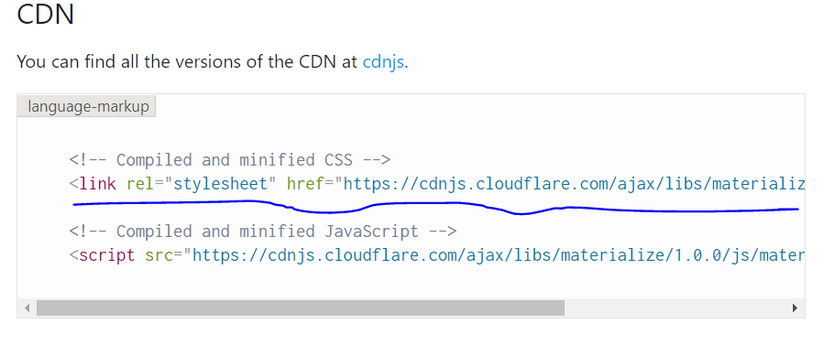
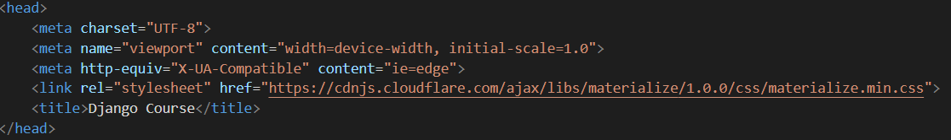
Materialize CSS
Copy the link of the CSS file from the link
Paste it inside your layout file

Slide 10
Code inside body
container, center-aligned; these classes are defined in materialize CSS

Slide 11
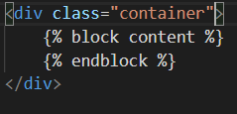
DTL
You have to tell django that layout.html file is not a normal file. It will be included in other files.
The way DTL handles this
It tells django that other files’ codes will be included here

Slide 12
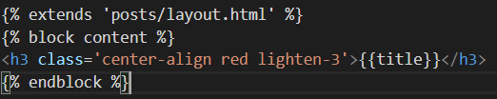
DTL
What will be the change in index.html file?
It is telling django to include layout.html file’s code at the beginning
Then the code inside block content & endblock will be placed in the layout.html’s appropriate place.

Slide 13
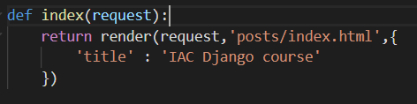
More about template
Do we always design static pages?
No, sometimes frontend needs some data from backend to display to the users
You can pass those data from views file’s methods to the HTML page
You will need to pass a third parameter in render method which will be a dictionary
Index method is passing a dictionary which contains a single variable named title

Slide 14
Accessing variable in template
How to access this variable from template?
Use double curly braces

Slide 15
Assignment of previous class
Remember the assignment to display all the posts of database in the posts/ url?
Try that, in case you haven’t done it yet
Hints
How to get the data from database?
Remember what we did in shell?
Fetch the data in index method
Now, pass these data to index.html and show them!

Slide 16
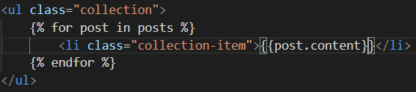
For loop in template
There is a problem. You may have many posts in the database. And you don’t know the exact number. How to show all of them?
Use for loop -> DTL!

Slide 17
Parameter in url
What about clicking one post and the user is redirected to its detail page?
What will be the url?
re_path method is used to include any regular expression in the url

Slide 18
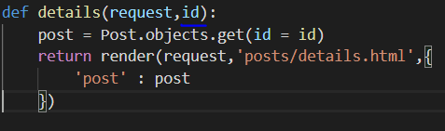
What will view pass to template
Only the post matching the id is being passed to the template.

Slide 19
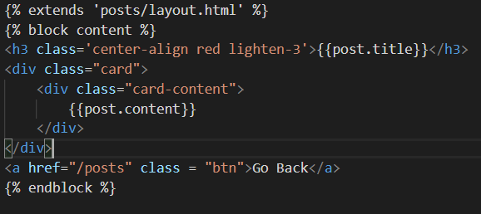
Template for a specific post
We are showing content of that post in the details page.

